Slide 1


A J INSTITUTE OF ENGINEERING AND TECHNOLOGY
(A unit of Laxmi Memorial Education Trust®)
PRESENTATION ON
IDEASPARK
UNDER THE GUIDENCE
Dr. Antony PJ
HOD, Dept of CSE
AJIET, Mangalore
PRESENTED BY
GAURESH G PAI [4JK22CS016]
HIMANSHU HEGDE [4JK22CS018]
JNANESH [4JK22CS020]
MILAN C I [4JK22CS027]

Slide 2
PROBLEM STATEMENT
In the rapidly evolving digital landscape, the need for effective AI interaction has become increasingly crucial. As AI technologies permeate various aspects of our lives, the challenge of crafting clear and impactful instructions for AI systems becomes more apparent. This difficulty is exacerbated by the wide range of AI application scenarios, which require tailored prompts for optimal performance across diverse fields. Moreover, there exists a significant knowledge gap in prompt formulation, with a stark contrast in expertise between experienced and novice users. This gap often results in poor-quality prompts, leading to inefficient AI usage and user frustration. Addressing these challenges, IdeaSpark aims to bridge this gap by providing an intuitive platform for discovering, creating, and sharing AI-generated prompts, thereby enhancing AI efficiency and improving the overall user experience.

Slide 3
Welcome to IdeaSpark🚀

Slide 4
IdeaSpark is your go-to open-source AI prompting tool, designed to ignite your creativity. Discover, create, and share captivating prompts generated by advanced artificial intelligence. Dive into the world of inspiration with IdeaSpark!
Key Features
Discover & Share: Explore an extensive collection of AI-generated prompts to spark your creativity.
AI-Powered Prompts: Our sophisticated AI algorithms generate unique and inspiring prompts tailored for your creative pursuits.
Open Source: IdeaSpark is built on open-source technologies, encouraging collaboration and innovation.
User Authentication
Login Using Google Auth: Seamlessly log in to IdeaSpark using your Google account for a secure and quick start.

Slide 5
User Profiles
Separate User Profiles: Each user has a personalized profile where their created prompts are stored and displayed.
Visit Profiles: View profiles of other users to see all their prompts and get inspired.
Synchronized Prompt Display
Home Page Feed: View prompts created by all users in a synchronized and suggested display on the homepage.
Search Functionality: Search prompts based on creator name, tags, or specific prompt words.
Copy and Navigate
Copy Prompts: Easily copy any prompt and navigate to ChatGPT for further exploration and interaction.

Slide 6
Usage
The home page provides an introduction to IdeaSpark, highlighting its purpose and features.
The main feature is the interactive feed where you can discover a variety of AI-generated prompts.
Embrace your creativity and use these prompts as a starting point for your artistic endeavors.
Technologies Used
Next.js: The foundation for building React applications with server-side rendering.
AI Algorithms: Advanced algorithms power our prompt generation, providing unique and engaging content.
Tailwind CSS: A utility-first CSS framework for building modern and responsive designs.

Slide 7
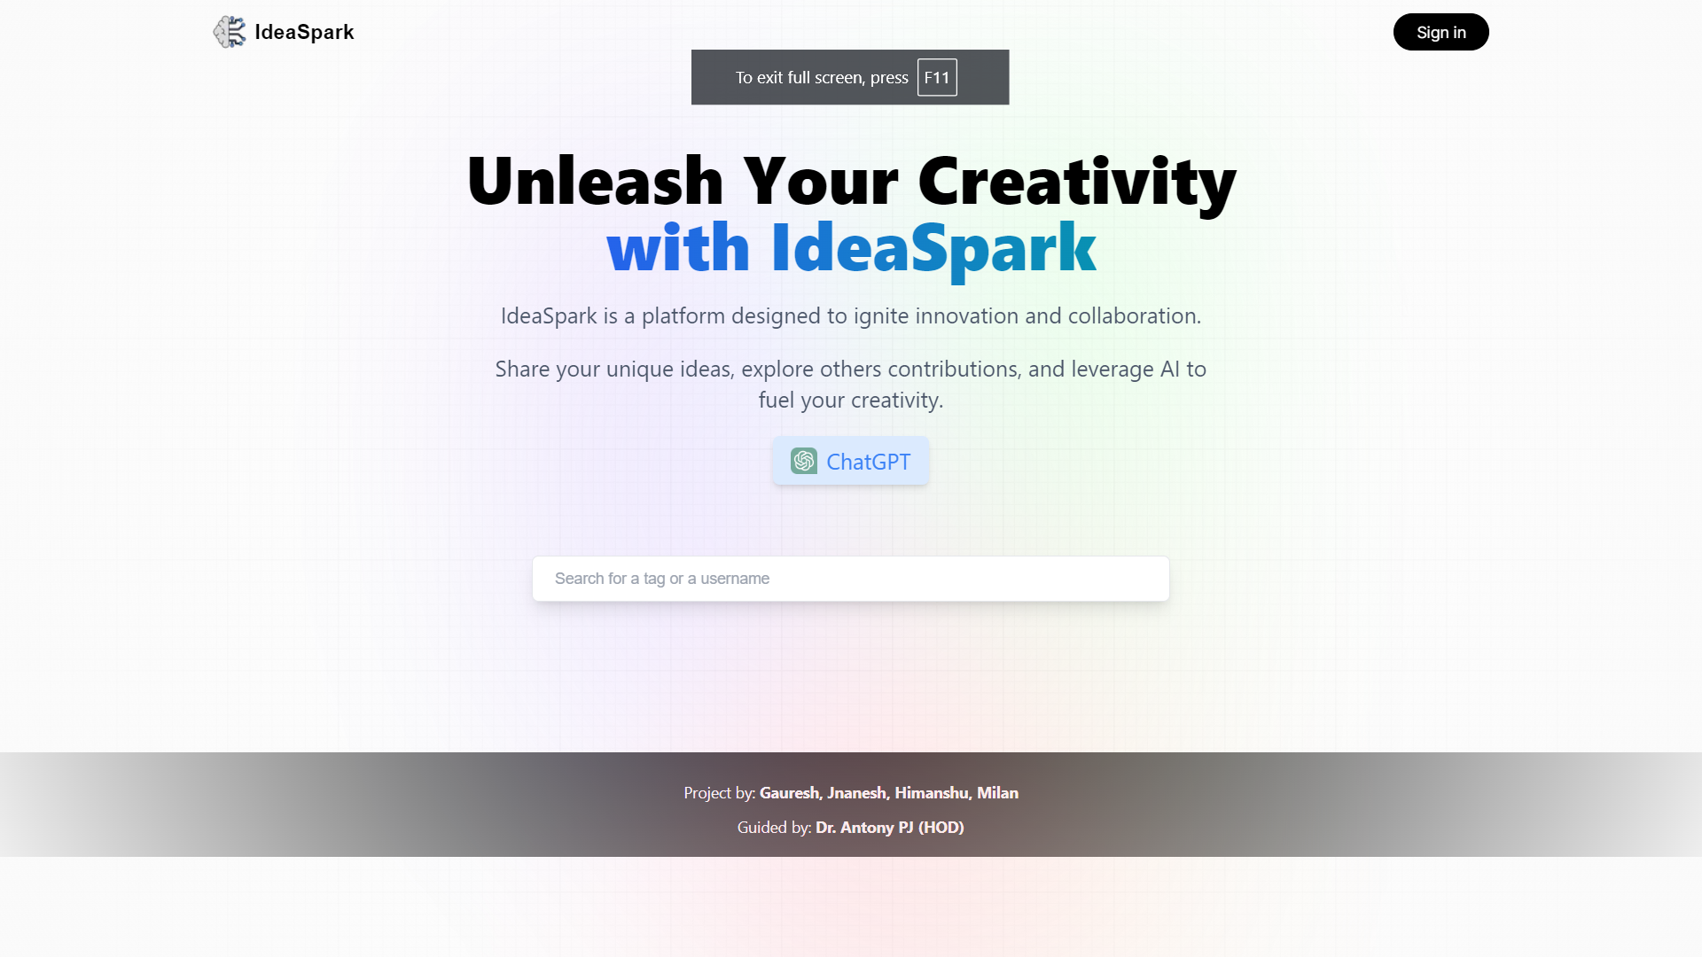

Slide 8
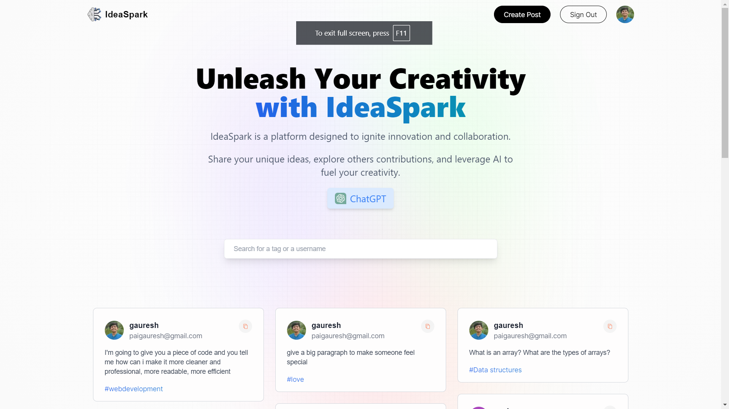

Slide 9
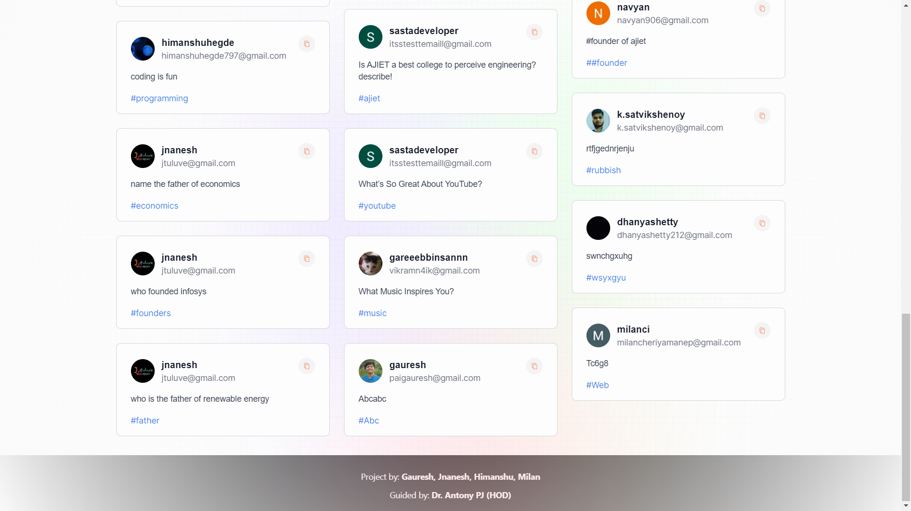

Slide 10
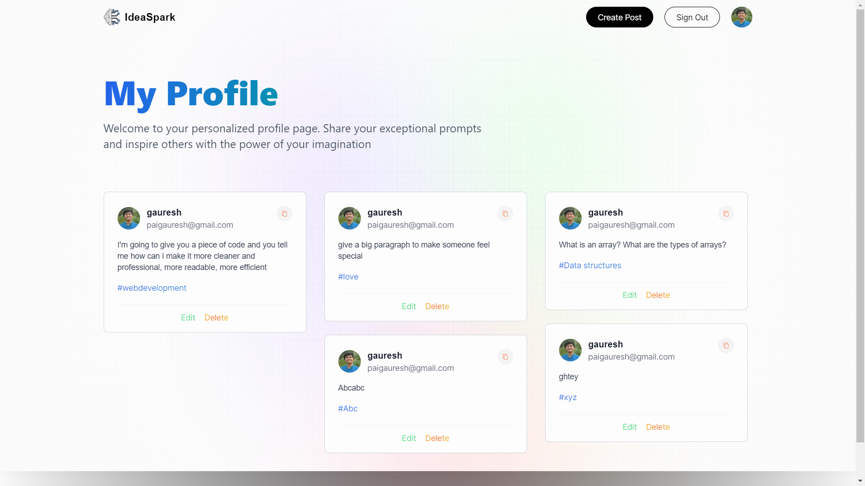

Slide 11
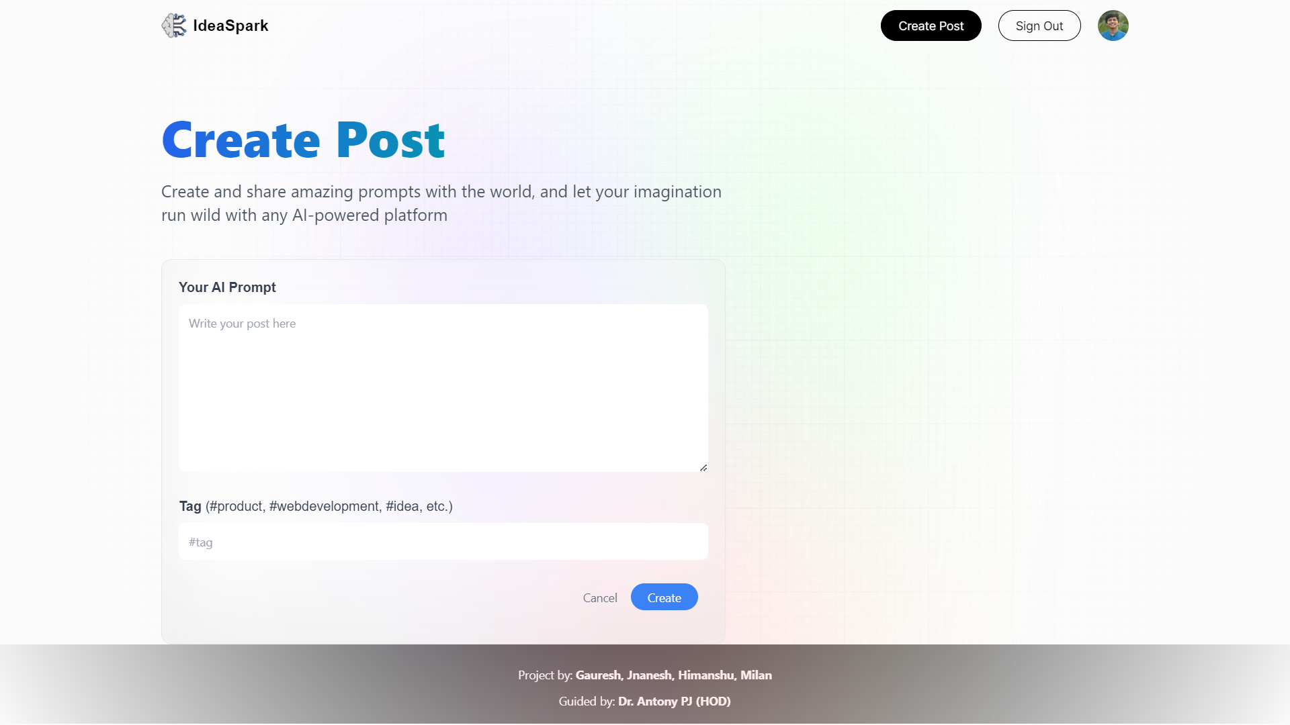

Slide 13
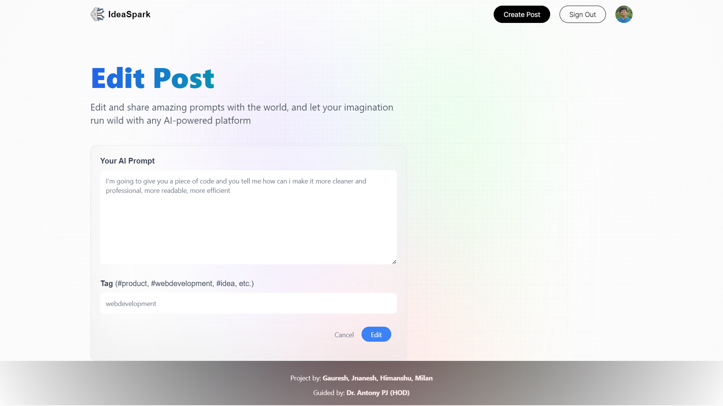

Slide 14
Thank you for joining us on this creative journey with IdeaSpark! 🎉

